Slide 1
Design and Software Architecture

Slide 2
Outline
What is design
How can a system be decomposed into modules
What is a module’s interface
What are the main relationships among modules
Prominent software design techniques and information hiding
The UML collection of design notations
Design of concurrent and distributed software
Design patterns
Architectural styles
Component based software engineering

Slide 3
What is design?
Provides structure to any artifact
Decomposes system into parts, assigns responsibilities, ensures that parts fit together to achieve a global goal
Design refers to both an activity and the result of the activity

Slide 4
Two meanings of "design“ activity in our context
Activity that acts as a bridge between requirements and the implementation of the software
Activity that gives a structure to the artifact
  e.g., a requirements specification document must be designed
    must be given a structure that makes it easy to understand and evolve

Slide 5
The sw design activity
Defined as system decomposition into modules
Produces a Software Design Document
  describes system decomposition into modules
Often a software architecture is produced prior to a software design

Slide 6
Software architecture
Shows gross structure and organization of the system to be defined
Its description includes description of
  main components of a system
  relationships among those components
  rationale for decomposition into its components
  constraints that must be respected by any design of the components
Guides the development of the design

Slide 7
Two important goals
Design for change (Parnas)
  designers tend to concentrate on current needs
  special effort needed to anticipate likely changes
Product families (Parnas)
  think of the current system under design as a member of a program family

Slide 8
Sample likely changes? (1)
Algorithms
  e.g., replace inefficient sorting algorithm with a more efficient one
Change of data representation
  e.g., from binary tree to a threaded tree (see example)
  ≈17% of maintenance costs attributed to data representation changes (Lientz and Swanson, 1980)

Slide 9
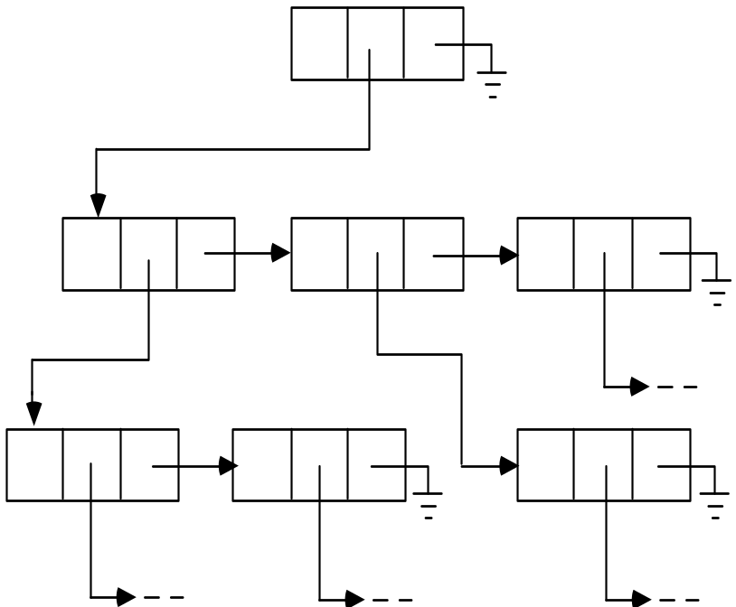
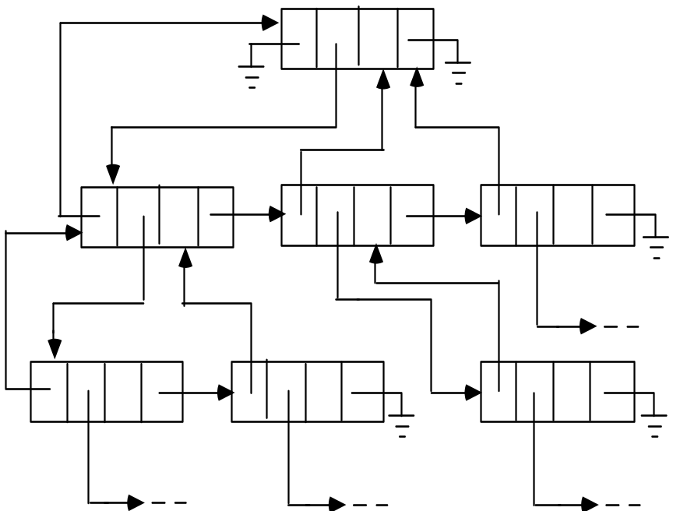
Example

Slide 10
Sample likely changes? (2)
Change of underlying abstract machine
  new release of operating system
  new optimizing compiler
  new version of DBMS
  …
Change of peripheral devices
Change of "social" environment
  new tax regime
  EURO vs national currency in EU
Change due to development process (transform prototype into product)

Slide 11
Product families
Different versions of the same system
  e.g. a family of mobile phones
    members of the family may differ in network standards, end-user interaction languages, …
  e.g. a facility reservation system
    for hotels: reserve rooms, restaurant, conference space, …, equipment (video beamers, overhead projectors, …)
    for a university
      many functionalities are similar, some are different (e.g., facilities may be free of charge or not)

Slide 12
Design goal for family
Design the whole family as one system, not each individual member of the family separately

Slide 13
Sequential completion: the wrong way
Design first member of product family
Modify existing software to get next member products

Slide 14
Sequential completion: a graphical view
Requirements
Requirements
Requirements
1
1
intermediate
design
1
2
2
final
product
2
Version 1
Version 1
3
3
3
4
6
4
4
Version 1
Version 2
5
7
Version 3
Version 2
5

Slide 15
How to do better
Anticipate definition of all family members
Identify what is common to all family members, delay decisions that differentiate among different members
We will learn how to manage change in design

Slide 16
Module
A well-defined component of a software system
A part of a system that provides a set of services to other modules
  Services are computational elements that other modules may use

Slide 17
Questions
How to define the structure of a modular system?
What are the desirable properties of that structure?

Slide 18
Modules and relations
Let S be a set of modules
S = {M₁, M₂, . . ., M_{n}}
A binary relation r on S is a subset of
S x S
If M_{i} and M_{j} are in S, <M_{i}, M_{j}> ∈ r can be written as M_{i} r M_{j}

Slide 19
Relations
Transitive closure r⁺ of r
M_{i} r⁺ M_{j} iff
M_{i} r M_{j} or ∃ M_{k} in S s.t. M_{i} r M_{k} and M_{k} r⁺ M_{j}
(We assume our relations to be irreflexive)
r is a hierarchy iff there are no two elements M_{i}, M_{j} s.t. M_{i} r⁺ M_{j} ∧ M_{j} r⁺ M_{i}

Slide 20
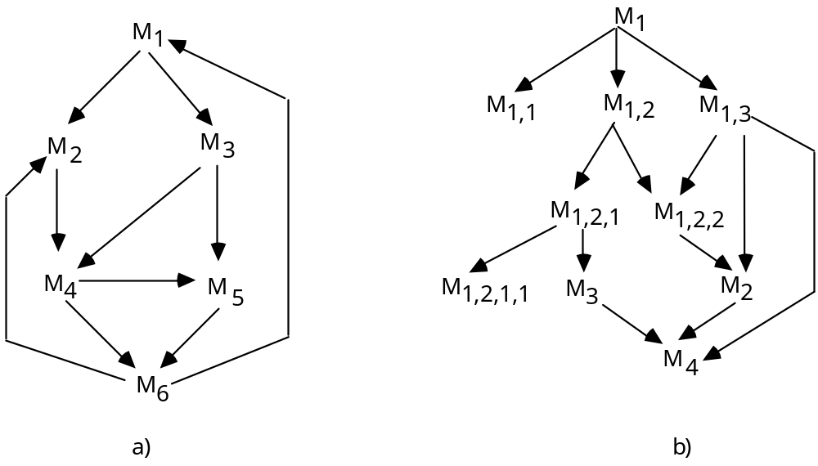
Relations
Relations can be represented as graphs
A hierarchy is a DAG (directed acyclic graph)
a graph
a DAG

Slide 21
The USES relation
A uses B
  A requires the correct operation of B
  A can access the services exported by B through its interface
  it is “statically” defined
  A depends on B to provide its services
    example: A calls a routine exported by B
A is a client of B; B is a server

Slide 22
Desirable property
USES should be a hierarchy
Hierarchy makes software easier to understand
  we can proceed from leaf nodes (who do not use others) upwards
They make software easier to build
They make software easier to test

Slide 23
Hierarchy
Organizes the modular structure through levels of abstraction
Each level defines an abstract (virtual) machine for the next level
  level can be defined precisely
    M_{i} has level 0 if no M_{j} exists s.t. M_{i} r M_{j}
    let k be the maximum level of all nodes M_{j} s.t. M_{i} r M_{j}. Then M_{i} has level k+1

Slide 24
IS_COMPONENT_OF
Used to describe a higher level module as constituted by a number of lower level modules
A IS_COMPONENT_OF B
  B consists of several modules, of which one is A
B COMPRISES A
M_{S,i}={M_{k}|M_{k}∈S∧M_{k} IS_COMPONENT_OF M_{i}}
we say that M_{S,i} IMPLEMENTS M_{i}

Slide 25
A graphical view
M
M
M
M
M
M
7
8
9
5
6
1
M
M
3
M
4
2
M
M
M
4
2
3
M
M
M
M
M
M
1
7
8
9
5
6
(IS_COMPONENT_OF)
(COMPRISES)
They are a hierarchy

Slide 26
Product families
Careful recording of (hierarchical) USES relation and IS_COMPONENT_OF supports design of program families

Slide 27
Interface vs. implementation (1)
To understand the nature of USES, we need to know what a used module exports through its interface
The client imports the resources that are exported by its servers
Modules implement the exported resources
Implementation is hidden to clients

Slide 28
Interface vs. implementation (2)
Clear distinction between interface and implementation is a key design principle
Supports separation of concerns
  clients care about resources exported from servers
  servers care about implementation
Interface acts as a contract between a module and its clients

Slide 29
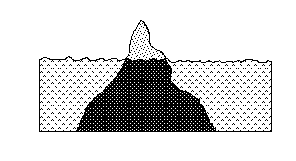
Interface vs. implementation (3)
interface is like the tip of the iceberg

Slide 30
Information hiding
Basis for design (i.e. module decomposition)
Implementation secrets are hidden to clients
They can be changed freely if the change does not affect the interface
Golden design principle
  INFORMATION HIDING
    Try to encapsulate changeable design decisions as implementation secrets within module implementations

Slide 31
How to design module interfaces?
Example: design of an interpreter for language MINI
  We introduce a SYMBOL_TABLE module
    provides operations to
      CREATE an entry for a new variable
      GET the value associated with a variable
      PUT a new value for a given variable
  the module hides the internal data structure of the symbol table
  the data structure may freely change without affecting clients

Slide 32
Interface design
Interface should not reveal what we expect may change later
It should not reveal unnecessary details
Interface acts as a firewall preventing access to hidden parts

Slide 33
Prototyping
Once an interface is defined, implementation can be done
  first quickly but inefficiently
  then progressively turned into the final version
Initial version acts as a prototype that evolves into the final product

Slide 34
More on likely changes an example
Policies may be separated from mechanisms
    mechanism
      ability to suspend and resume tasks in a concurrent system
    policy
      how do we select the next task to resume?
        different scheduling policies are available
        they may be hidden to clients
        they can be encapsulated as module secrets

Slide 35
Design notations
Notations allow designs to be described precisely
They can be textual or graphic
We illustrate two sample notations
  TDN (Textual Design Notation)
  GDN (Graphical Design Notation)
We discuss the notations provided by UML

Slide 36
TDN & GDN
Illustrate how a notation may help in documenting design
Illustrate what a generic notation may look like
Are representative of many proposed notations
TDN inherits from modern languages, like Java, Ada, …

Slide 37
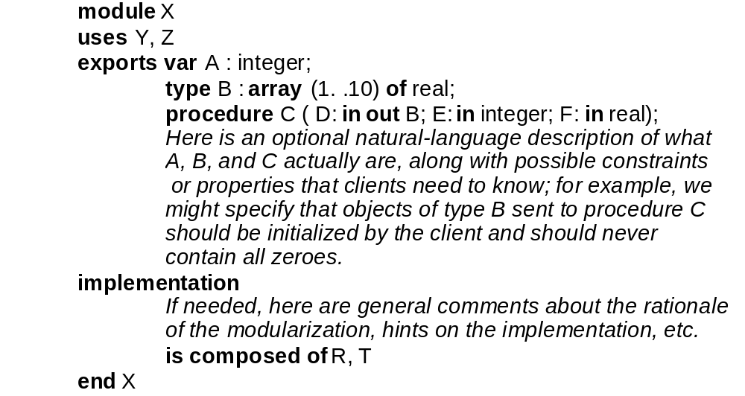
An example

Slide 38
Comments in TDN
May be used to specify the protocol to be followed by the clients so that exported services are correctly provided
  e.g., a certain operation which does the initialization of the module should be called before any other operation
  e.g., an insert operation cannot be called if the table is full

Slide 39
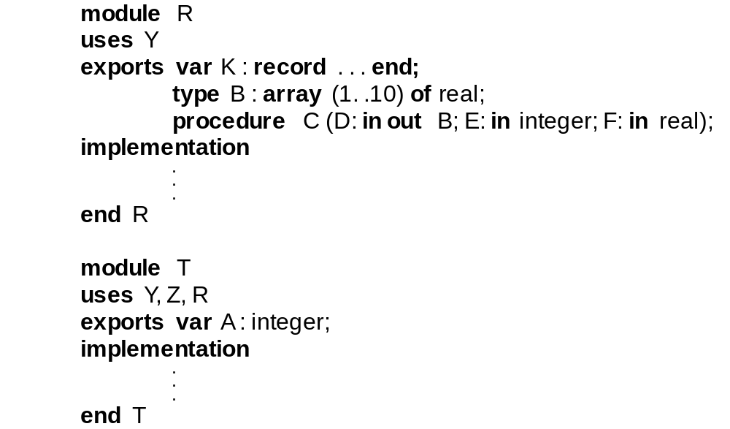
Example (cont.)

Slide 40
Benefits
Notation helps describe a design precisely
Design can be assessed for consistency
  having defined module X, modules R and T must be defined eventually
    if not → incompleteness
  R, T replace X
    → either one or both must use Y, Z

Slide 41
Example: a compiler
module COMPILER
exports procedure MINI (PROG: in file of char;
CODE: out file of char);
MINI is called to compile the program stored in PROG
and produce the object code in file CODE
implementation
A conventional compiler implementation.
ANALYZER performs both lexical and syntactic analysis
and produces an abstract tree, as well as entries in the
symbol table; CODE_GENERATOR generates code
starting from the abstract tree and information stored
in the symbol table. MAIN acts as a job coordinator.
is composed of ANALYZER, SYMBOL_TABLE,
ABSTRACT_TREE_HANDLER, CODE_GENERATOR, MAIN
end COMPILER

Slide 42
Other modules
module MAIN
uses ANALYZER, CODE_GENERATOR
exports procedure MINI (PROG: in file of char;
CODE: out file of char);
…
end MAIN
module ANALYZER
uses SYMBOL_TABLE, ABSTRACT_TREE_HANDLER
exports procedure ANALYZE (SOURCE: in file of char);
SOURCE is analyzed; an abstract tree is produced
by using the services provided by the tree handler,
and recognized entities, with their attributes, are
stored in the symbol table.
...
end ANALYZER

Slide 43
Other modules
module CODE_GENERATOR
uses SYMBOL_TABLE, ABSTRACT_TREE_HANDLER
exports procedure CODE (OBJECT: out file of char);
The abstract tree is traversed by using the
operations exported by the
ABSTRACT_TREE_HANDLER and accessing
the information stored in the symbol table
in order to generate code in the output file.
…
end CODE_GENERATOR

Slide 44
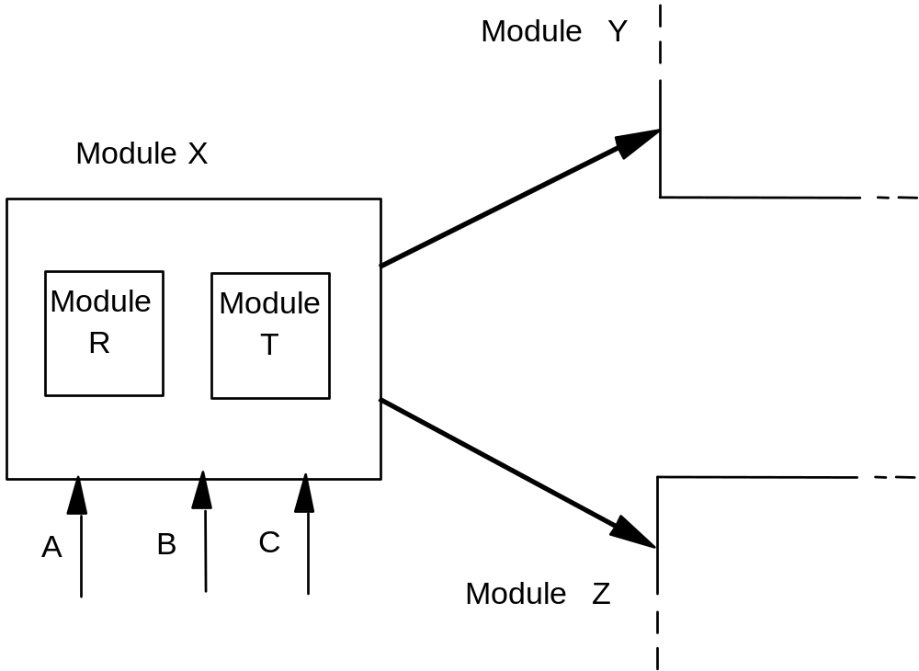
GDN description of module X

Slide 45
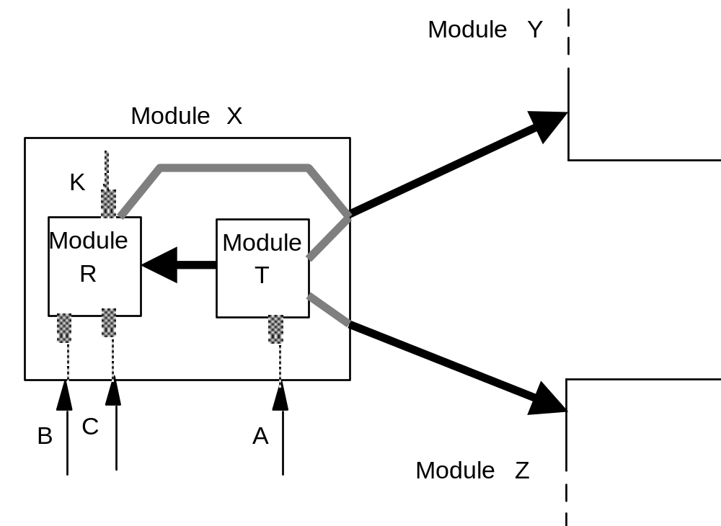
X's decomposition

Slide 46
Categories of modules
Functional modules
  traditional form of modularization
  provide a procedural abstraction
  encapsulate an algorithm
    e.g. sorting module, fast Fourier transform module, …

Slide 47
Categories of modules (cont.)
Libraries
  a group of related procedural abstractions
    e.g., mathematical libraries
      implemented by routines of programming languages
Common pools of data
  data shared by different modules
    e.g., configuration constants
      the COMMON FORTRAN construct

Slide 48
Categories of modules (cont.)
Abstract objects
  Objects manipulated via interface functions
  Data structure hidden to clients
Abstract data types
  Many instances of abstract objects may be generated

Slide 49
Abstract objects: an example
A calculator of expressions expressed in Polish postfix form
  a*(b+c) → abc+*
a module implements a stack where the values of operands are shifted until an operator is encountered in the expression
(assume only binary operators)

Slide 50
Example (cont.)
Interface of the abstract object STACK
exports
procedure PUSH (VAL: in integer);
procedure POP_2 (VAL1, VAL2: out integer);

Slide 51
Design assessment
How does the design anticipate change in type of expressions to be evaluated?
  e.g., it does not adapt to unary operators

Slide 52
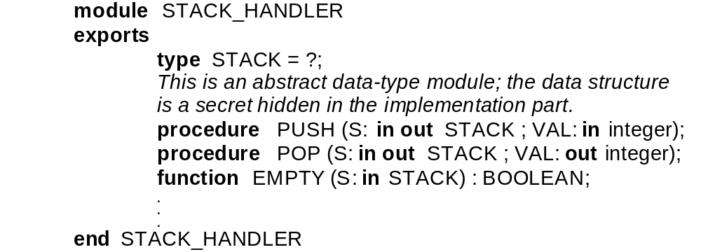
Abstract data types (ADTs)
A stack ADT
indicates that details of the
data structure are hidden
to clients

Slide 53
ADTs
Correspond to Java and C++ classes
Concept may also be implemented by Ada private types and Modula-2 opaque types
May add notational details to specify if certain built-in operations are available by default on instance objects of the ADT
  e.g., type A_TYPE: ? (:=, =) indicates that assignment and equality check are available

Slide 54
An example: simulation of a gas station
module FIFO_CARS
uses CARS
exports
type QUEUE : ?;
procedure ENQUEUE (Q: in out QUEUE ; C: in CARS);
procedure DEQUEUE (Q: in out QUEUE ; C: out CARS);
function IS_EMPTY (Q: in QUEUE) : BOOLEAN;
function LENGTH (Q: in QUEUE) : NATURAL;
procedure MERGE (Q1, Q2 : in QUEUE ; Q : out QUEUE);
This is an abstract data-type module representing
queues of cars, handled in a strict FIFO way;
queues are not assignable or checkable for equality,
since “:=” and “=” are not exported.
…
end FIFO_CARS

Slide 55
Generic modules (templates)
They are parametric wrt a type
generic module GENERIC_STACK_2
. . .
exports
procedure PUSH (VAL : in T);
procedure POP_2 (VAL1, VAL2 : out T);
…
end GENERIC_STACK_2

Slide 56
Instantiation
Possible syntax:
  module INTEGER_STACK_2 is GENERIC_STACK_2 (INTEGER)

Slide 57
More on genericity
How to specify that besides a type also an operation must be provided as a parameter
  generic module M (T) with OP(T)
  uses ...
  ...
  end M
Instantiation
  module M_A_TYPE is M(A_TYPE) PROC(M_A_TYPE)

Slide 58
Specific techniques for design for change
Use of configuration constants
  factoring constant values into symbolic constants is a common implementation practice
    e.g., #define in C
    #define MaxSpeed 5600;

Slide 59
Specific techniques for design for change (cont.)
Conditional compilation
  ...source fragment common to all versions...
  # ifdef hardware-1
  ...source fragment for hardware 1 ...
  # endif
  #ifdef hardware-2
  ...source fragment for hardware 2 ...
  # endif
Software generation
  e.g., compiler compilers (yacc, interface prototyping tools)

Slide 60
Stepwise refinement
A systematic, iterative program design technique that unfortunately may lead to software that is hard to evolve
At each step, problem P decomposed into
  sequence of subproblems: P1; P2; …Pn
  a selection: if (cond) then P1 else P2
  an iteration: while (cond) do_something

Slide 61
Example derivation of selection sort
Step 1
let n be the length of the array a to be sorted;
i := 1 ;
while i < n loop
find the smallest of ai .. .an, and exchange
it with the element at position i;
i := i + 1;
end loop;

Slide 62
Step 2
let n be the length of the array a to be sorted;
i := 1 ;
while i < n loop
j := n;
while j > i loop
if a(i) > a(j) then
interchange the elements at positions j and i ;
end if;
j := j - 1;
end loop;
i := i + 1;
end loop;

Slide 63
Step 3
let n be the length of the array a to be sorted;
i := 1 ;
while i < n loop
j := n;
while j > i loop
if a(i) > a(j) then
x := a(i);
a(i) := a(j);
a(j) := x;
end if;
j := j - 1;
end loop;
i := i + 1;
end loop;

Slide 64
Decomposition tree
Stepwise refinement process may be depicted by a decomposition tree (DT)
  root labeled by name of top problem
  subproblem nodes labeled as children of parent node corresponding to problem
  children from left to right represent sequential order of execution
  if and while nodes denoted by suitable decoration

Slide 65
Example
Step 1
P; P problem to solve
Step 2
P1; P2; P3; P decomposed into sequence
Step 3
P1;
while C loop
P2,1; P2 decomposed into a loop
end loop;
P3;
Step 4
P1;
while C loop
if C1 then P2,1 decomposed into selection
P2,1,1;
else
P2,1,2;
end if;
end loop;
P3;

Slide 66
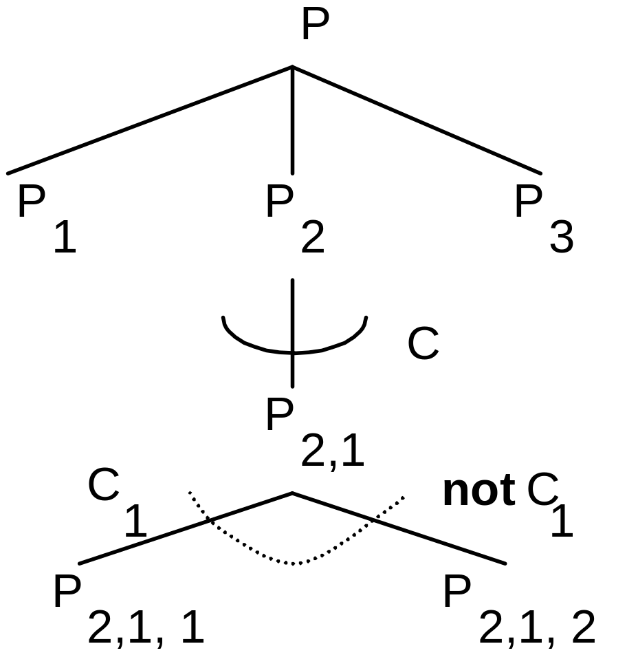
Corresponding DT

Slide 67
Relation with IS_COMPOSED_OF
Let M, M1, M2, M3 be modules representing P, P1, P2, P3
We cannot write
  M IS_COMPOSED_OF {M1,M2,M3}
We need to add further module acting as glue to impose a sequential flow from M1 to M2 to M3

Slide 68
An assessment of stepwise refinement (1)
Stepwise refinement is a programming technique, not a modularization technique
When used to decompose system into modules, it tends to analyze problems in isolation, not recognizing commonalities
It does not stress information hiding

Slide 69
An assessment of stepwise refinement (2)
No attention is paid to data (it decomposes functionalities)
Assumes that a top function exists
  but which one is it in the case of an operating system? or a word processor?
Enforces premature commitment to control flow structures among modules

Slide 70
Example a program analyzer
Step 1
Recognize a program stored in a given file f;
Step 2
correct := true;
analyze f according to the language definition;
if correct then
print message "program correct";
else
print message "program incorrect";
end if;

Slide 71
Step 3
correct := true;
perform lexical analysis:
store program as token sequence in file ft
and symbol table in file fs, and set error_in_lexical_phase
accordingly;
if error_in_lexical_phase then
correct := false;
else
perform syntactic analysis and set Boolean variable
error_in_syntactic_phase accordingly:
if error_in_syntactic_phase then
correct := false;
end if;
end if;
if correct then
print message "program correct";
else
print message "program incorrect";
end if;

Slide 72
Commitments
Two passes
  Lexical analysis comes first on the entire program, producing two files
What if we want to switch to a process driven by syntax analysis (it requests the lexical analyzer to provide a token when needed)
  everything changes!!!

Slide 73
A better design based on information hiding
Module CHAR_HOLDER
  hides physical representation of input file
  exports operation to access source file on a character-by-character basis
Module SCANNER
  hides details of lexical structure of the language
  exports operation to provide next token
Module PARSER
  hides data structure used to perform syntactic analysis (abstract object PARSER)

Slide 74
Top-down vs. bottom-up
Information hiding proceeds bottom-up
Iterated application of IS_COMPOSED_OF proceeds top-down
  stepwise refinement is intrinsically top-down
Which one is best?
  in practice, people proceed in both directions
    yo-yo design
  organizing documentation as a top-down flow may be useful for reading purposes, even if the process followed was not top-down

Slide 75
Handling anomalies
Defensive design
A module is anomalous if it fails to provide the service as expected and as specified in its interface
An exception MUST be raised when anomalous state is recognized

Slide 76
How can failures arise?
Module M should fail and raise an exception if
  one of its clients does not satisfy the required protocol for invoking one of M’s services
  M does not satisfy the required protocol when using one of its servers, and the server fails
  hardware generated exception (e.g., division by zero)

Slide 77
What a module can do before failing
Before failing, modules may try to recover from the anomaly by executing some exception handler (EH)
  EH is a local piece of code that may try to recover from anomaly (if successful, module does not fail)
  or may simply do some cleanup of the module’s state and then let the module fail, signaling an exception to its client

Slide 78
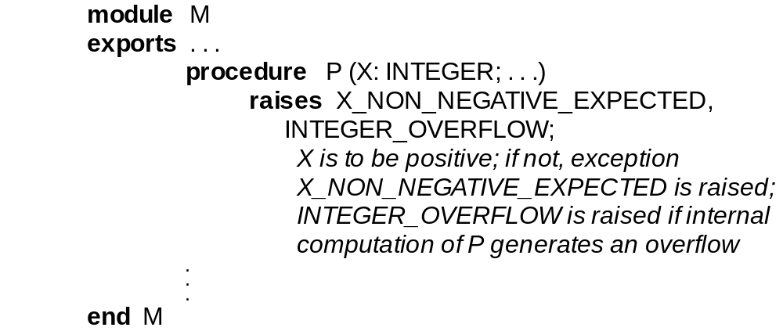
Example

Slide 79
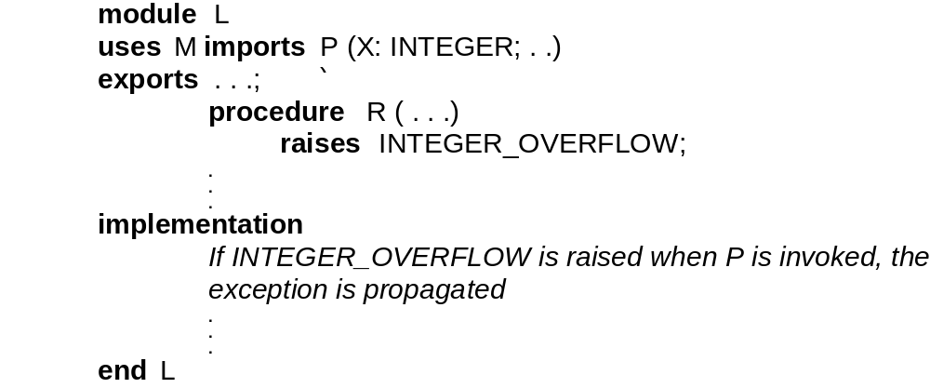
Example of exception propagation

Slide 80
Case study
Compiler for the MIDI programming language
The language is block-structured
It requires a symbol table module that can cope with block static nesting
We discuss here module SYMBOL_TABLE

Slide 81
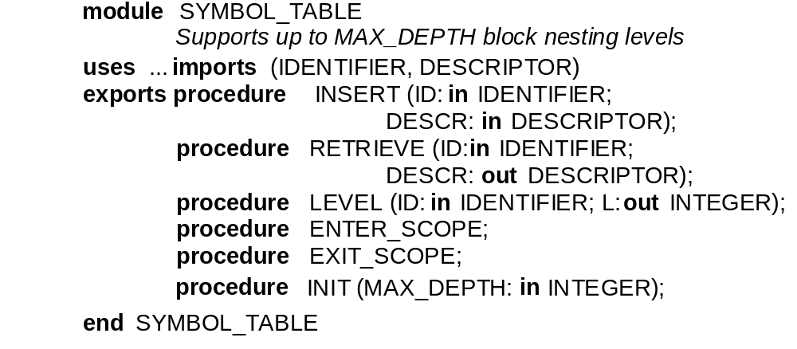
SYMBOL_TABLE (vers.1)

Slide 82
Version 1 is not robust
Defensive design should be applied
Exceptions must be raised in these cases:
  INSERT: insertion cannot be done because identifier with same name already exists in current scope
  RETRIEVE and LEVEL: identifier with specified name not visible
  ENTER_SCOPE: maximum nesting depth exceeded
  EXIT_SCOPE: no matching block entry exists

Slide 83
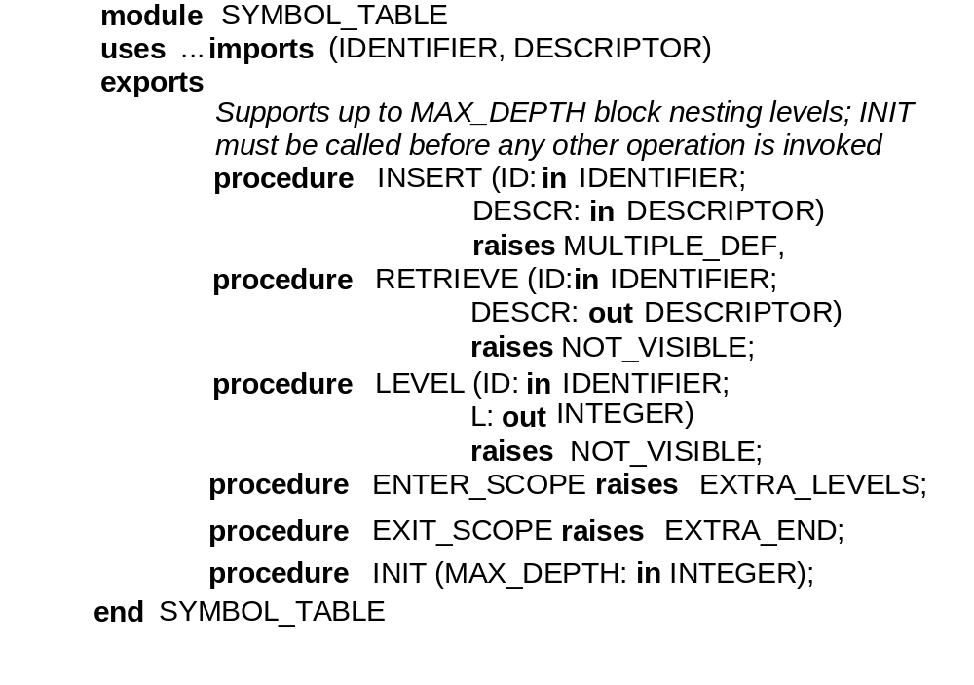
SYMBOL_TABLE (vers.2)

Slide 84
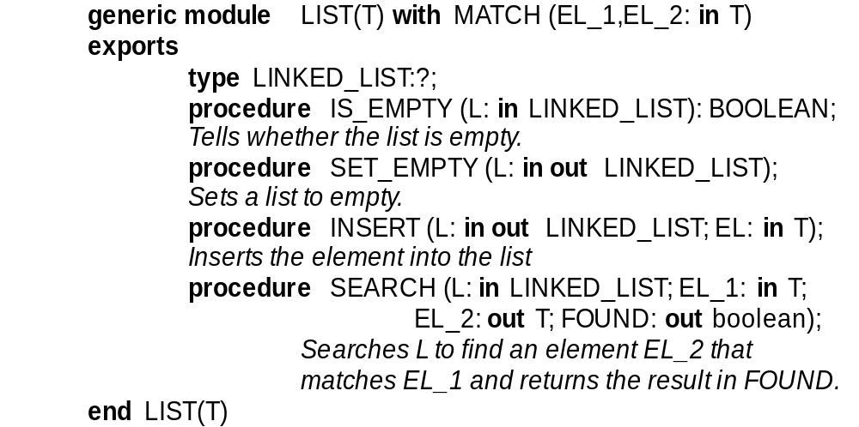
SYMBOL_TABLE uses a list management module

Slide 85
Concurrent software
The case of a module defining shared data
E.g., abstract object BUFFER
  module QUEUE_OF_CHAR is GENERIC_FIFO_QUEUE (CHAR)
  BUFFER : QUEUE_OF_CHAR.QUEUE
with operations
  PUT: inserts a character in BUFFER
  GET: extracts a character from BUFFER
  NOT_FULL: returns true if BUFFER not full
  NOT_EMPTY: returns true if BUFFER not empty

Slide 86
How to control correct access to shared data?
Not sufficient that clients check operation invocations, such as
    if QUEUE_OF_CHAR.NOT_FULL (BUFFER) then QUEUE_OF_CHAR.PUT (X, BUFFER);
    end if;
Consumer_1 and Consumer_2 might do this concurrently
    if only one slot is left, both may find the buffer not full, the first who writes fills it, and the other writes in a full buffer

Slide 87
Enforcing synchronization
Ensure that operations on buffer are executed in mutual exclusion
Ensure that operations such as
    if QUEUE_OF_CHAR.NOT_FULL (BUFFER) then QUEUE_OF_CHAR.PUT (X, BUFFER);
    end if;
are executed as logically non-interruptible units

Slide 88
Monitors
Abstract objects used in a concurrent environment
Available in the Java programming language

Slide 89
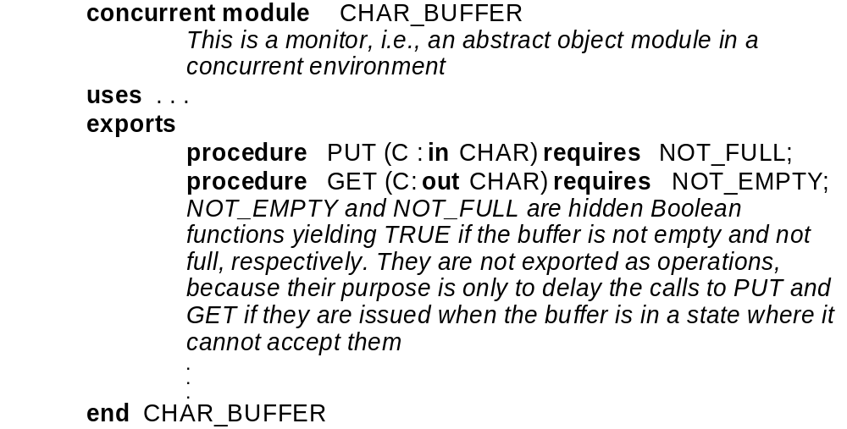
Monitors: an example

Slide 90
Comments
Monitor operations are assumed to be executed in mutual exclusion
A requires clause may be associated with an operation
  it is automatically checked when operation is called
  if the result is false, the current process is suspended until it becomes true (at that stage it becomes eligible for resumption)

Slide 91
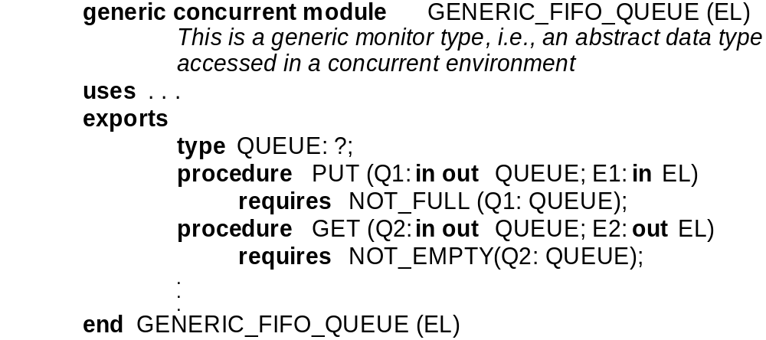
Monitor types: an example

Slide 92
Guardians and rendez-vous
The Ada style of designing concurrent systems
In Ada a shared object is active (whereas a monitor is passive)
  it is managed by a guardian process which can accept rendez-vous requests from tasks willing to access the object

Slide 93
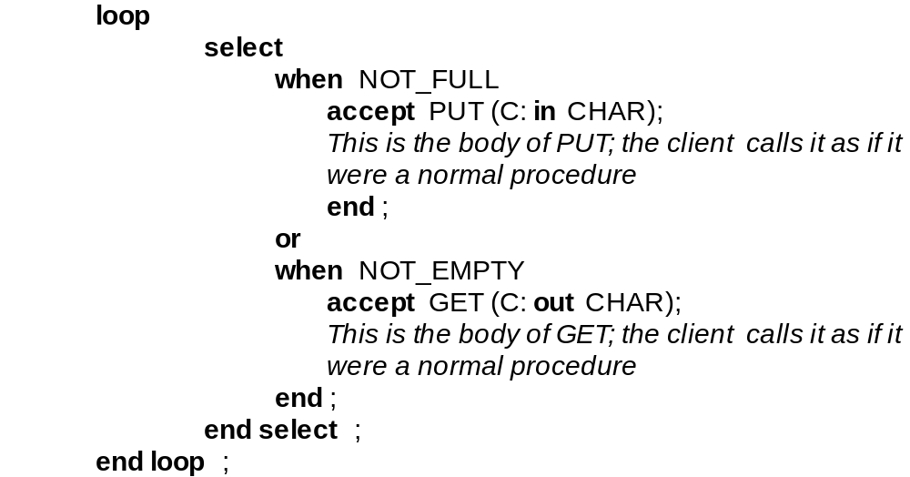
A guardian task
note nondeterministic acceptance of
rendez-vous requests

Slide 94
Real-time software
Case where processes interact with the environment
E.g., a put operation on a shared buffer is invoked by a plant sensor sending data to a controller
  plant cannot be suspended if buffer full!
    design must ensure that producer never finds the buffer full
      this constrains the speed of the consumer process in the controller

Slide 95
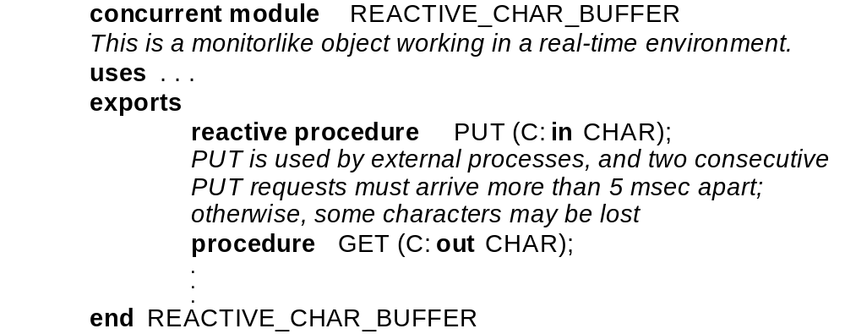
TDN description

Slide 96
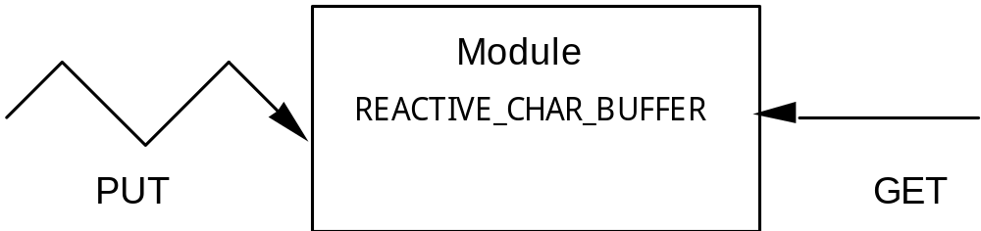
GDN description
zig-zag arrow indicates asynchronous invocation

Slide 97
Distributed software
Issues to consider
  module-machine binding
  intermodule communication
    e.g., remote procedure call or message passing
  access to shared objects
    may require replication for efficiency reasons

Slide 98
Client-server architecture
The most popular distributed architecture
Server modules provide services to client modules
Clients and servers may reside on different machines

Slide 99
Issues
Binding modules to machines
  static vs. dynamic (migration)
Inter-module communication
  e.g., RPC
  IDL to define interface of remote procedures
Replication and distribution

Slide 100
Middleware
Layer residing between the network operating system and the application
Helps building network applications
Provides useful services
  Name services, to find processes or resources on the network
  Communication services, such as message passing or RPC (or RMI)

Slide 101
Object-oriented design
One kind of module, ADT, called class
A class exports operations (procedures) to manipulate instance objects
  often called methods
Instance objects accessible via references

Slide 102
Syntactic changes in TDN
No need to export opaque types
  class name used to declare objects
If a is a reference to an object
  a.op (params);

Slide 103
A further relation: inheritance
ADTs may be organized in a hierarchy
Class B may specialize class A
  B inherits from A
conversely, A generalizes B
A is a superclass of B
B is a subclass of A

Slide 104
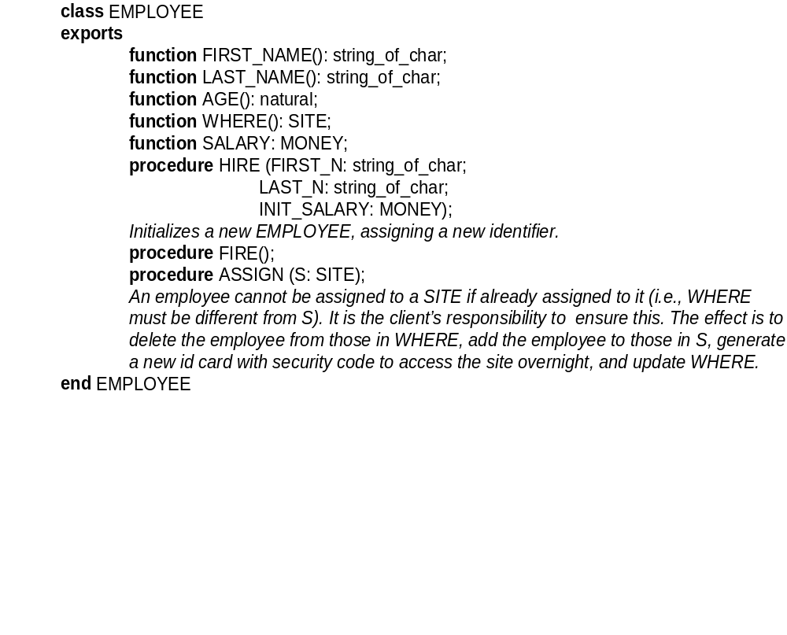
An example

Slide 105
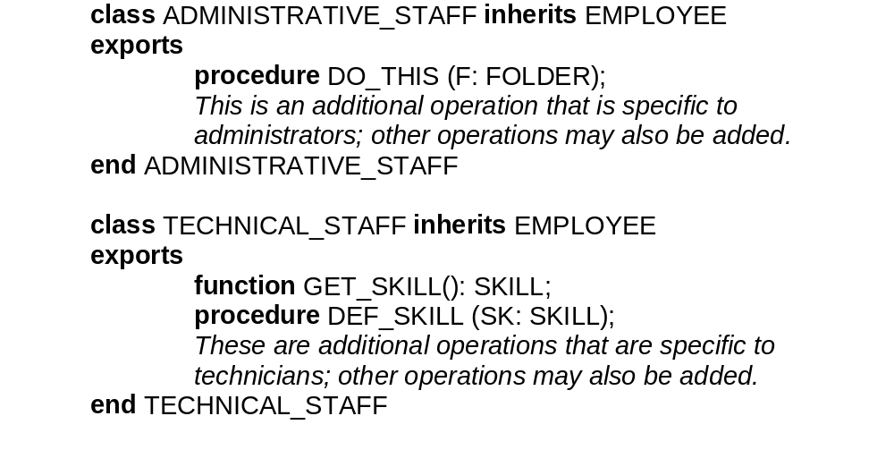

Slide 106
Inheritance
A way of building software incrementally
A subclass defines a subtype
  subtype is substitutable for parent type
Polymorphism
  a variable referring to type A can refer to an object of type B if B is a subclass of A
Dynamic binding
  the method invoked through a reference depends on the type of the object associated with the reference at runtime

Slide 107
How can inheritance be represented?
We start introducing the UML notation
UML (Unified Modeling Language) is a widely adopted standard notation for representing OO designs
We introduce the UML class diagram
  classes are described by boxes

Slide 108
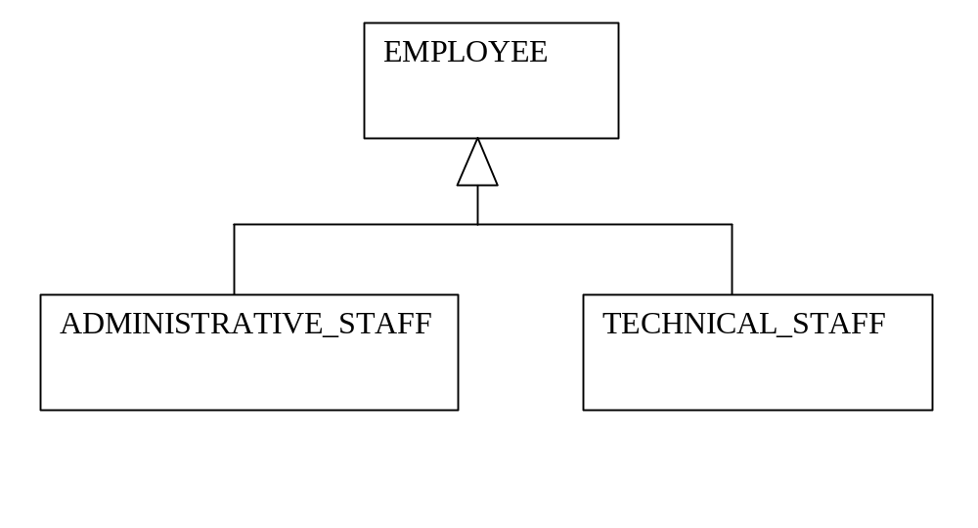
UML representation of inheritance

Slide 109
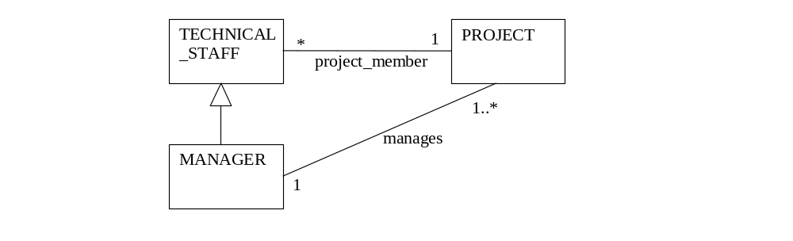
UML associations
Associations are relations that the implementation is required to support
Can have multiplicity constraints

Slide 110
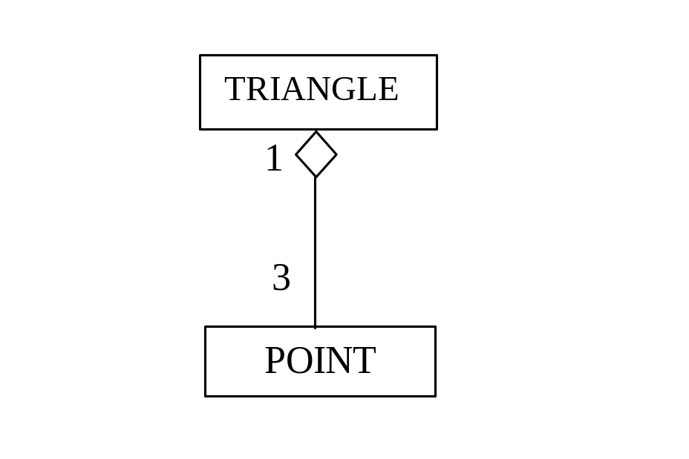
Aggregation
Defines a PART_OF relation
Differs from IS_COMPOSED_OF
Here TRANGLE has its own methods
It implicitly uses POINT to define
its data attributes

Slide 111
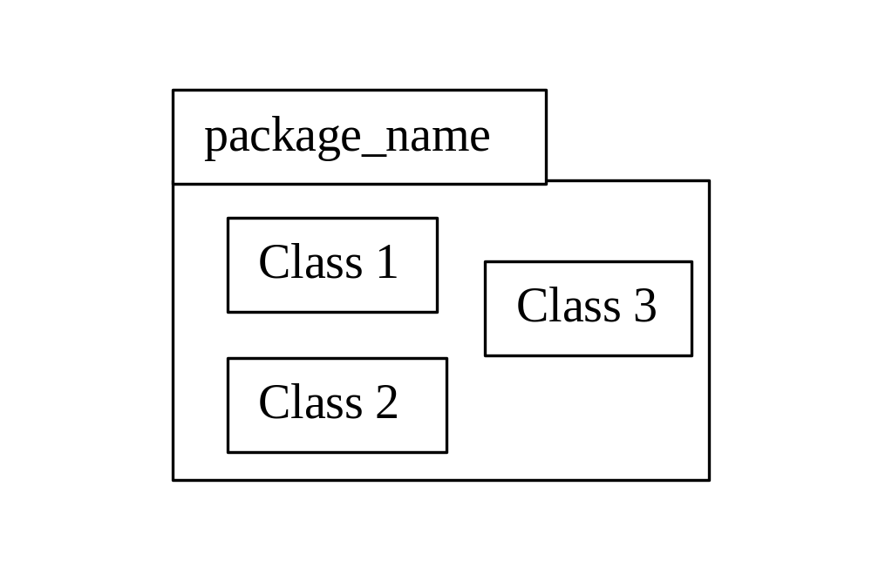
More on UML
Representation of IS_COMPONENT_OF via the package notation

Slide 112
Software architecture
Describes overall system organization and structure in terms of its major constituents and their interactions
Standard architectures can be identified
  pipeline
  blackboard
  event based (publish-subscribe)

Slide 113
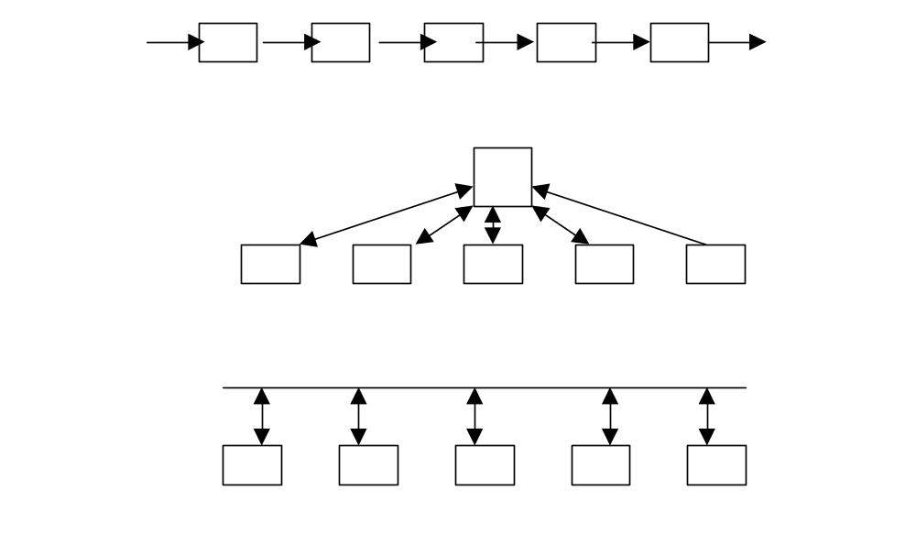
Standard architectures
pipeline
blackboard
event based

Slide 114
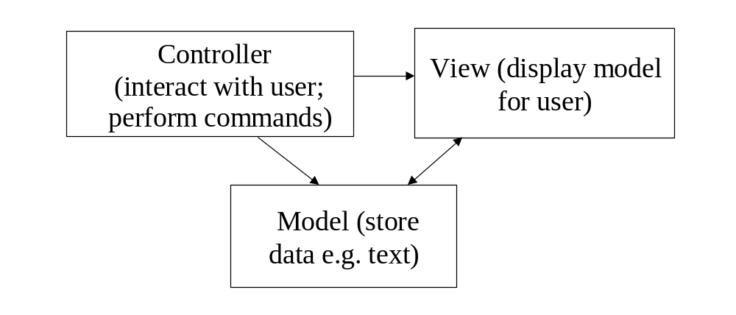
Domain specific architectures
"model–view–controller" architecture for software
that has a significant amount of user interaction

Slide 115
Software components
Goal
  build systems out of pre-existing libraries of components
  as most mature engineering areas do
Examples
  STL for C++
  JavaBeans and Swing for Java

Slide 116
Component integration
The CORBA (Common Object Request Broker Architecture) Middleware
Clients and servers connected via an Object Request Broker (ORB)
Interfaces provided by servers defined by an Interface Definition Language (IDL)
In the Microsoft world: DCOM (Distributed Component Object Model)

Slide 117
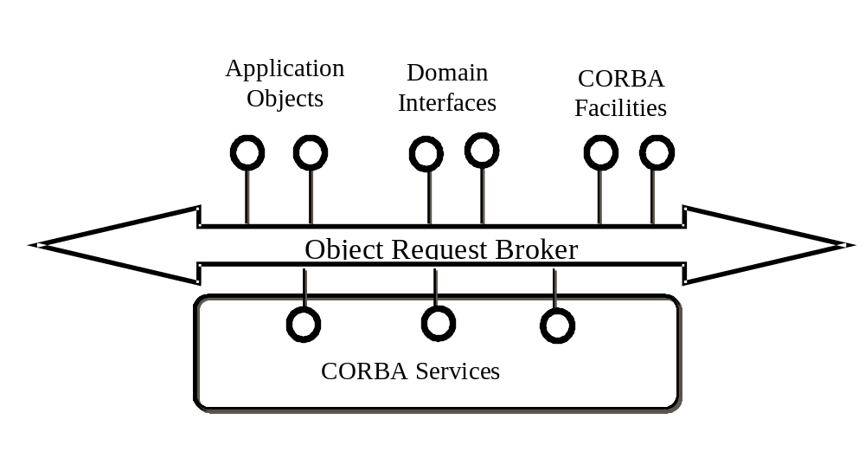
The CORBA architecture

Slide 118
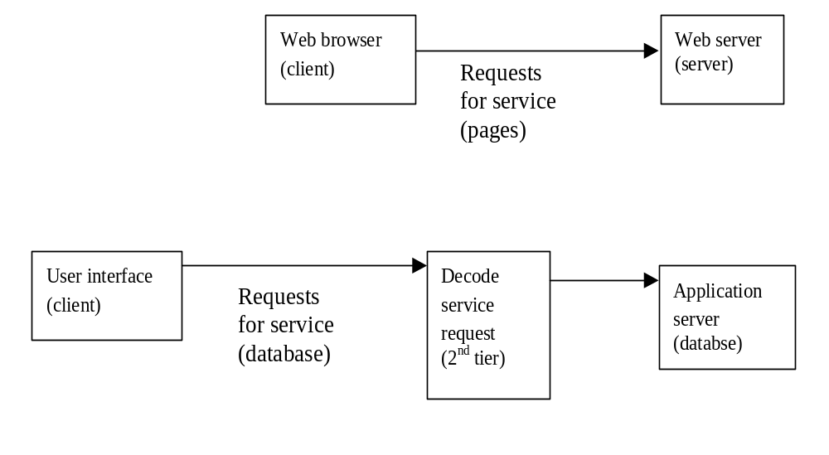
Architectures for distributed systems
From two tiered
  Client-server
to three tiered

